Slide 1
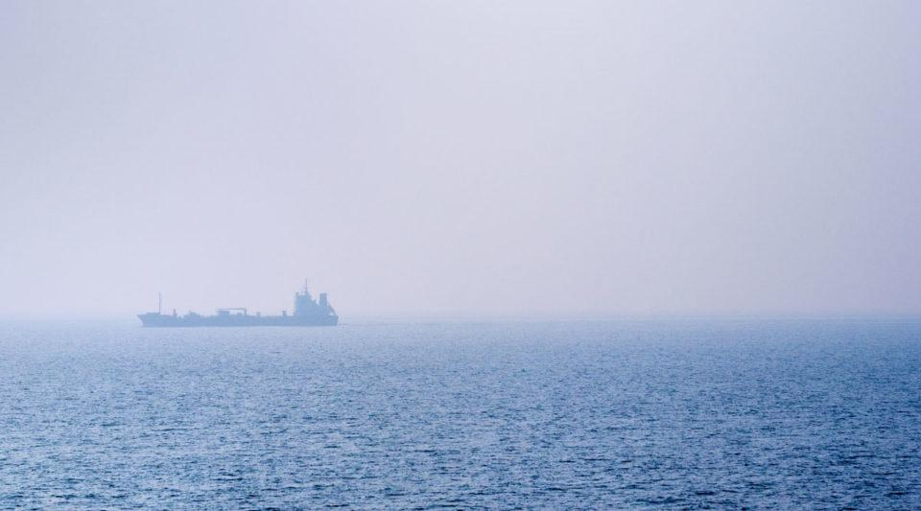
Assessing numerical predictions of fog in the Yellow Sea
David Llewellyn Smith, Luc Lenain,
Saša Gaberšek
https://engineering.nd.edu/news/marine-fog-comes-under-focus-in-new-five-year-study/
Notes:
Hi, during my project I worked on assessing numerical predictions of fog in the Yellow Sea.

Slide 2
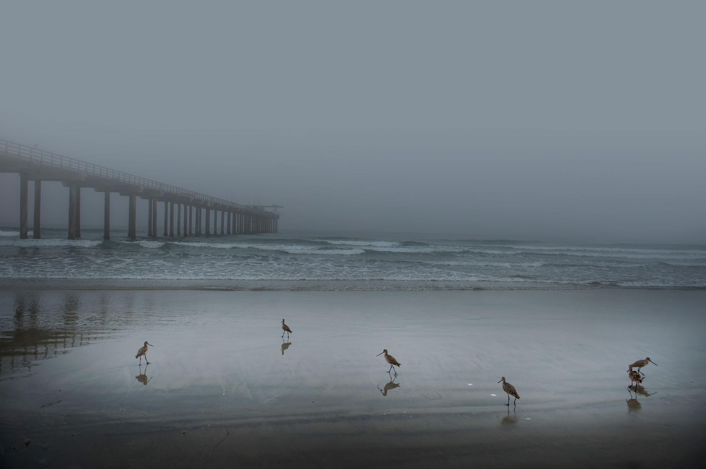
What is fog?
Water droplets suspended in air
1-30 µm
Reduces visibility to less than 1km
frankiefoto
Notes:
The first question I’m sure you all have is what is fog? Fog is tiny water droplets suspended in the air, with diameters ranging from 1 to 30 microns. In order to be classified as fog, it has to reduce visibility to less than 1 kilometer.

Slide 3
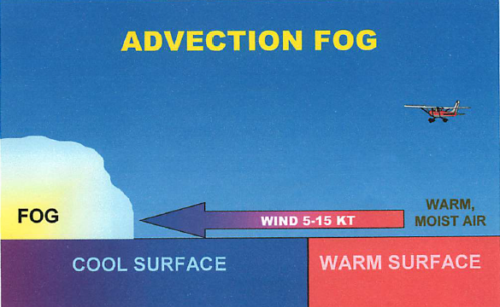
Advection fog
Warm, moist air passes over a cooler surface
Common in California (especially the Bay)
weather.gov
Notes:
Fog can form in a lot of different ways but the specific type of interest in my project is known as advection fog. That’s when warm moist air is blown (advected) to a cooler surface, creating a temperature inversion and condensing the water in the air. It’s very common in California - you see it here in San Diego and especially in the San Francisco Bay Area.

Slide 4

Why do we care?
Marine fog impacts human health, naval strategy, and biological productivity.
Current estimations of predictability ~50%
Complex air-sea-land interactions
Forms on small scales and evolves on large scales
Difficult to model
Difficult to sample
The New York Times
Notes:
Marine fog is super important because it can affect human health (reduced visibility can be dangerous), naval strategy (US navy wants to know how to hide a boat in the fog), and biological systems. A recent program named C-FOG worked on predicting fog and was only successful about half of the time. This is because fog is a very complex air-sea-land interaction that forms and evolves on different time and distance scales, some of which are very difficult to model, especially together. At the same time, since fog reduces visibility, it becomes harder to sample since you can’t see into the fog bank and observe the conditions there.

Slide 5
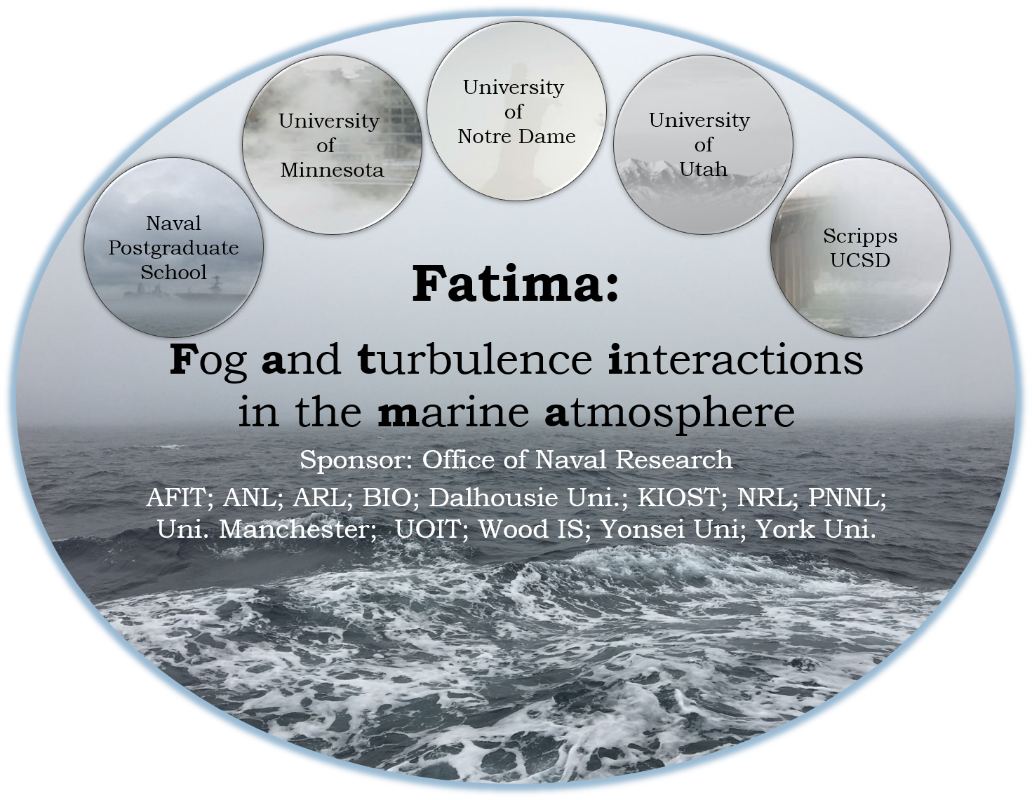
Notes:
Fog and turbulence interactions in the marine atmosphere is a joint program between here, Notre Dame, and other universities sponsored by ONR. I used results from a field campaign run by this project in my work this summer.

Slide 6
Objectives
Assess model performance relative to observations
Evaluate physical parameters correlated with fog
Examine conditions that lead to poor predictions
Notes:
My main goals were to assess model performance relative to what was observed, evaluate the parameters that are correlated with fog, and examine what conditions may have lead to poor predictions.

Slide 7
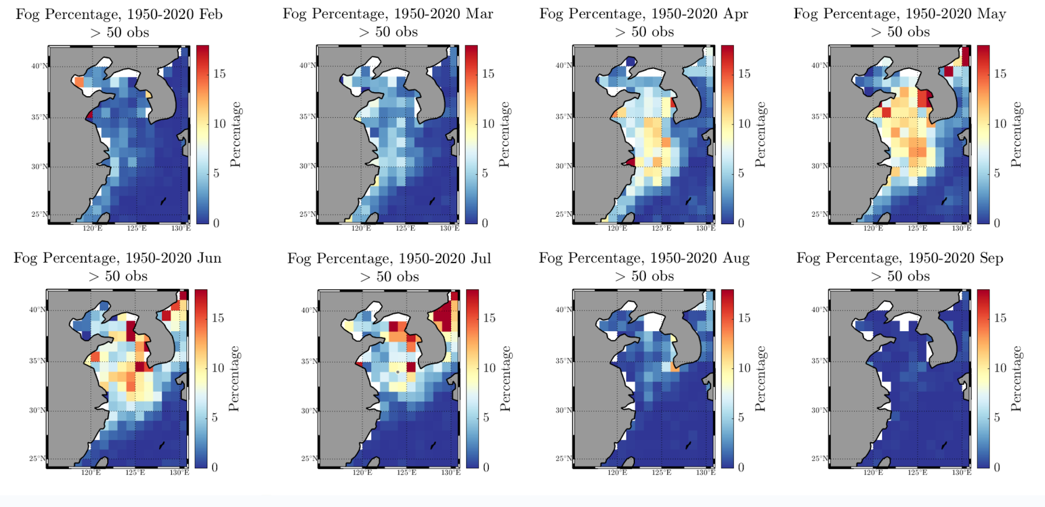
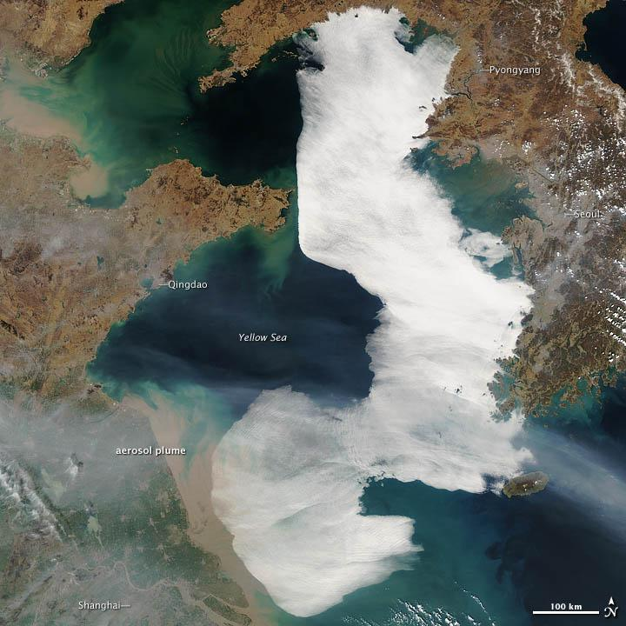
The Yellow Sea
Highest frequency of fog occurs between April and July
March 28, 2012
Nasa Earth Observatory
Ship path
Nasa Earth Observatory
Plots by Luc Lenain, using ICOADS archive
Notes:
The Yellow Sea is one of the foggiest marine areas in Asia. At its peak between April and July, fog can occur over 15% of the time. For example, in this event from 2012, most of the area was blanketed by fog.

Slide 8
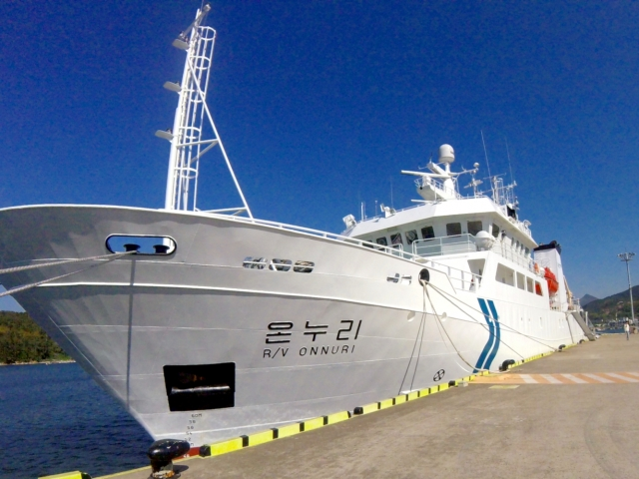
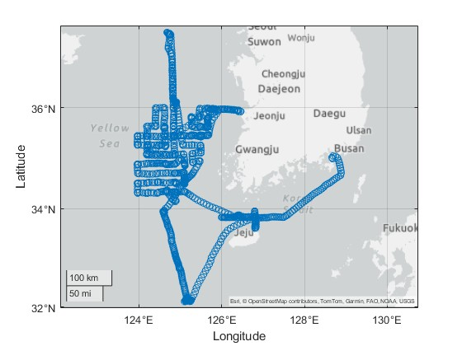
R/V Onnuri
Ship path
Notes:
In order to observe all of this, Fatima sent the research vessel Onnuri out of Busan to observe the Yellow Sea. It followed a lawnmower pattern west of the Korean Peninsula before traveling north to Socheongcho ORS and south to Ieodo ORS and passing by Jeju island on its way back to port.

Slide 9
Instrumentation
Instrumentation:
Sea-Bird Scientific Thermosalinograph
Meteorological stations
Vaisala CL51 ceilometer - measures visibility
Hammerhead Profiler
GPS systems
+ additional instrumentation not used here
Notes:
The Onnuri was fully equipped with instrumentation, including CTDs, meteorological sensors. A group of wave gliders was meant to be deployed but too many fishing boats in the area prevented this. This unfortunately means all of the observational data comes from the ship itself so we only have a single track of data.

Slide 10
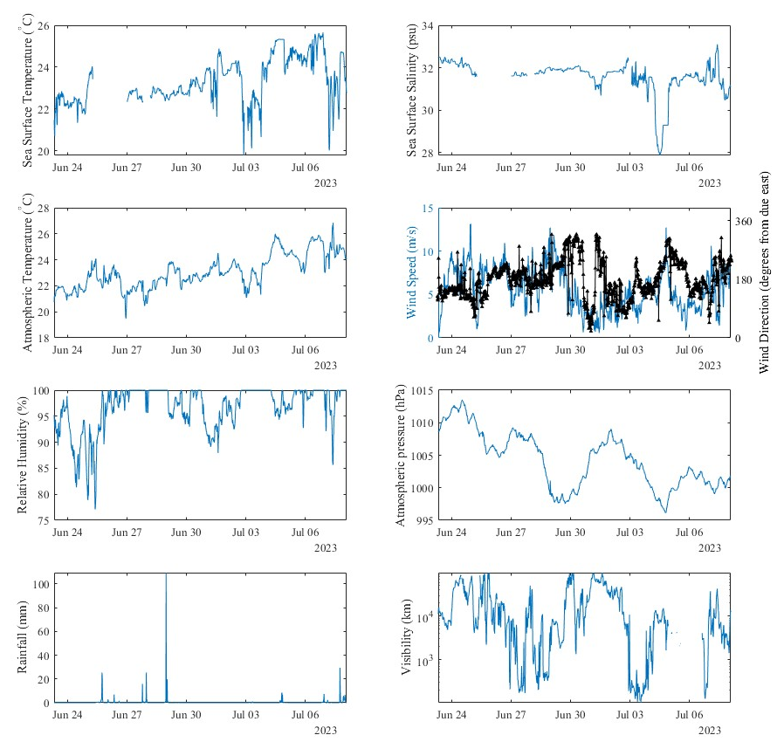
Observations
Data included:
Sea Surface temperature
Salinity
Atmospheric temperature
Wind speed
Wind direction
Humidity
Pressure
Precipitation
Visibility

Slide 11
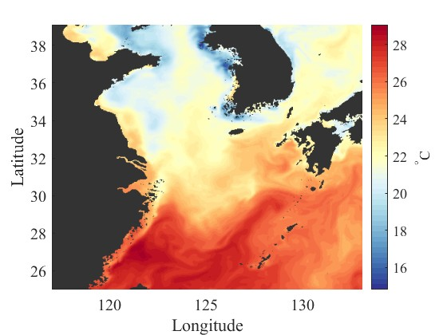
Models - NCOM
Navy Coastal Ocean Model
24h simulations with hourly time steps from 06/19/23 to 07/09/23
At 50 depth levels down to 5500m
Covering the East China Sea and the Yellow Sea
Temperature, salinity, current speeds
Notes:
I used data from two models in this project. For ocean data, I used the Navy Coastal Ocean Model. I had daily simulations run at midnight UTC with hourly time steps between June 19th and July 9th. On this map you can see the area the data covered. NCOM gave me sea temperature, salinity, and current speed data.

Slide 12
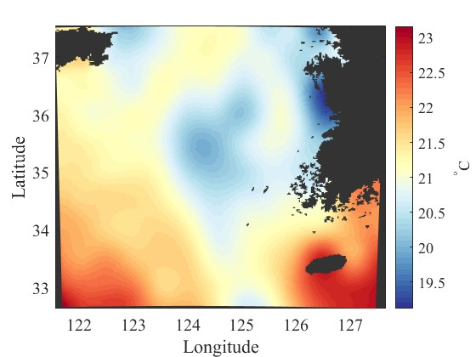
Models - COAMPS
Coupled Ocean/Atmosphere Mesoscale Prediction System
Used the atmospheric component
Same time scale as NCOM
Air temperature, relative humidity, visibility, wind speed
Over a smaller area than NCOM
Notes:
For atmospheric data, I used the Coupled Ocean/Atmosphere Mesoscale Prediction System. I had a much smaller spatial area than NCOM but luckily the cruise stayed within it for most of its length. From COAMPS, I had air temperature, relative humidity, two different predictions of visibility (one using concentration and one using relative humidity), and wind speed/direction.

Slide 13
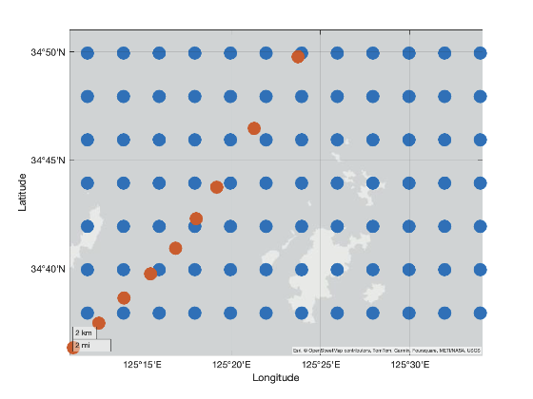
Interpolating
Models are large-scale simulations on a grid
In-situ data is a single path
How do we deal with that?
Interpolate the observed data onto the model’s time steps.
I then used the points on the model closest to each time step for the ship. The spatial resolution is good enough and this avoids the smoothing that interpolation can introduce, but a complete analysis would do both.
Model grid
Onnuri path
Notes:
An issue with comparing these is that the models are large-scale simulations on a grid while the observational data is a single path. That means there’s no perfect correspondence between the model data and in-situ data. To properly compare them, I interpolated the observed data to the model’s hourly time step. Then, I picked the points on the model grid closest to each time step. The spatial resolution is good and this avoids any smoothing, but I wish I had had time to do a proper 2-D interpolation.

Slide 14
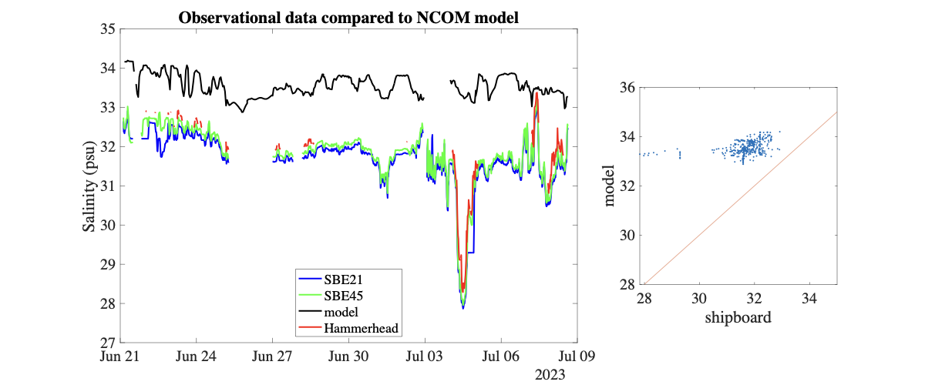
Comparisons - Salinity
Consistent positive bias from model in salinity
It doesn’t predict drop in salinity on July 4th
Correlation coefficient of 0.39 is good
Statistics
R = 0.39
P = 10⁻¹⁶

Slide 15
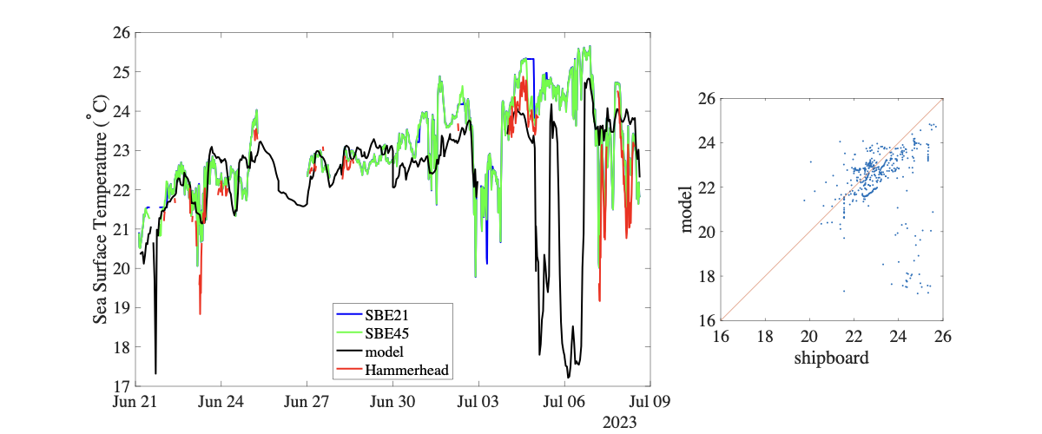
Comparisons - Sea Surface Temperature
Model predicts temperature drop on July 6th that was not observed
This causes low correlation coefficient
Statistics
R = 0.05
P = 0.30

Slide 16
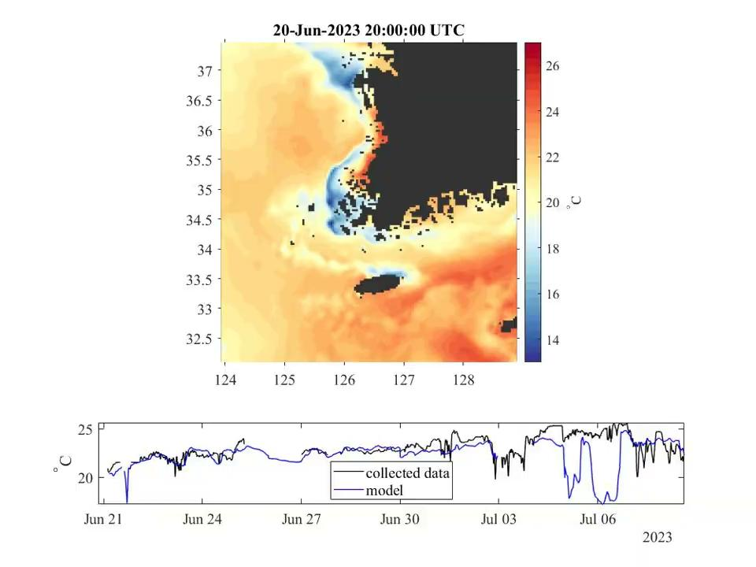
Comparisons - sea data
Breadcrumb video of surface sea temperature
On July 5th, Onnuri enters what NCOM predicts to be a cold region in the bottom left corner of the map and doesn’t observe any significant temperature difference

Slide 17
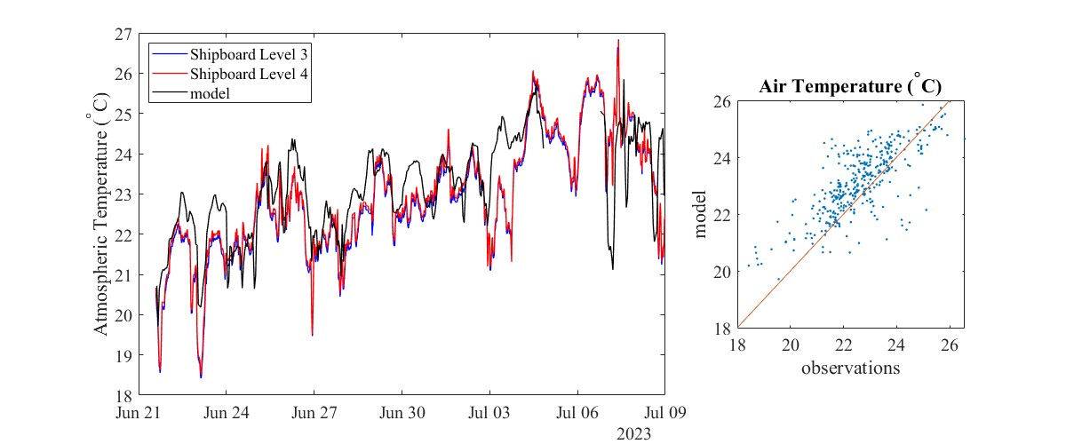
Comparisons - atmospheric temperature
Slight positive bias in prediction of air temperature
Level 3: z = 13.5m
Level 4: z = 11.7m
Statistics
R = 0.79
P = 10⁻¹⁶⁰

Slide 18
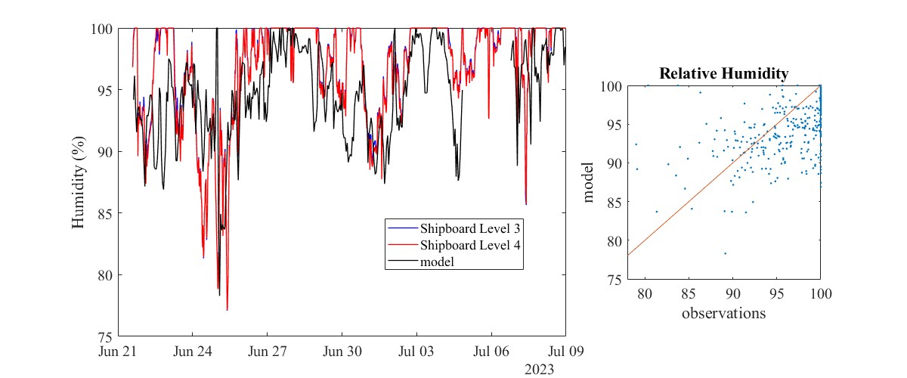
Comparisons - Humidity
Slight negative bias in prediction of humidity
Level 3: z = 13.5m
Level 4: z = 11.7m
Statistics
R = 0.57
P = 10⁻⁶⁵

Slide 19
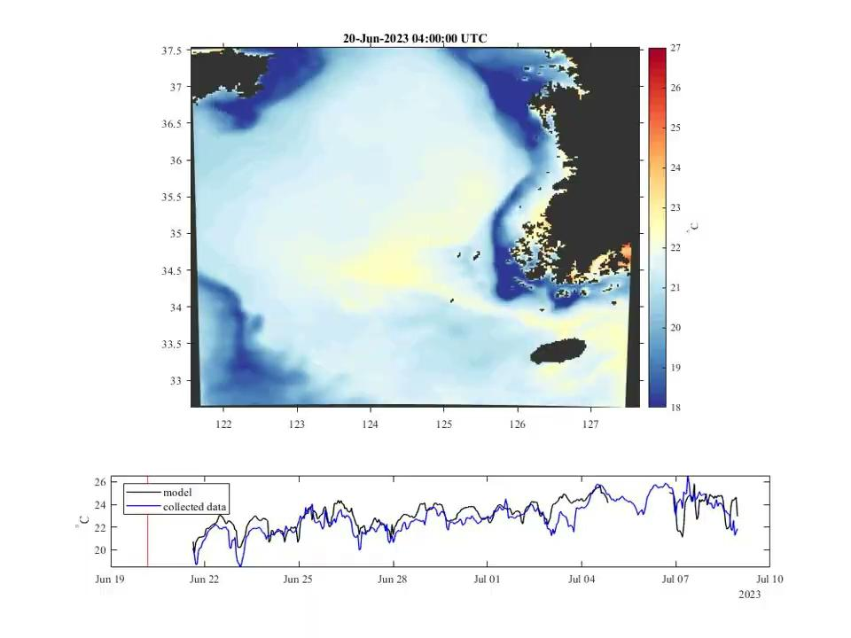
Comparisons - sea data
Breadcrumb animation of atmospheric temperature

Slide 20
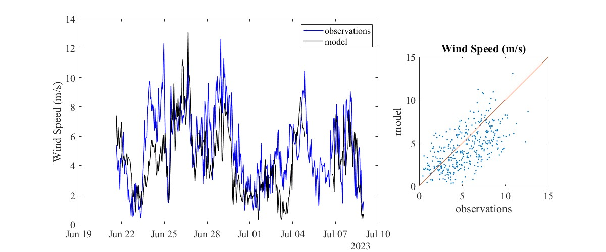
Comparisons - atmospheric data
WS = sqrt(u²+v²)
Correlation coefficient is statistically significant
Statistics
R = 0.63
P = 10⁻⁸⁵

Slide 21
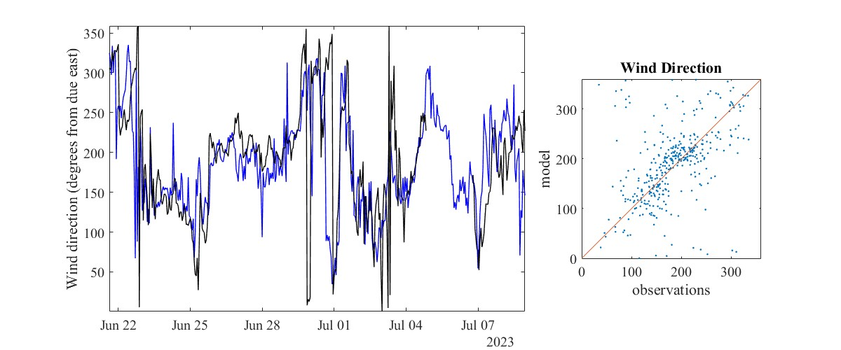
Comparisons - atmospheric data
WD = atan2(v/u)
Correlation coefficient is statistically significant
Statistics
R = 0.51
P = 10⁻⁵²

Slide 22
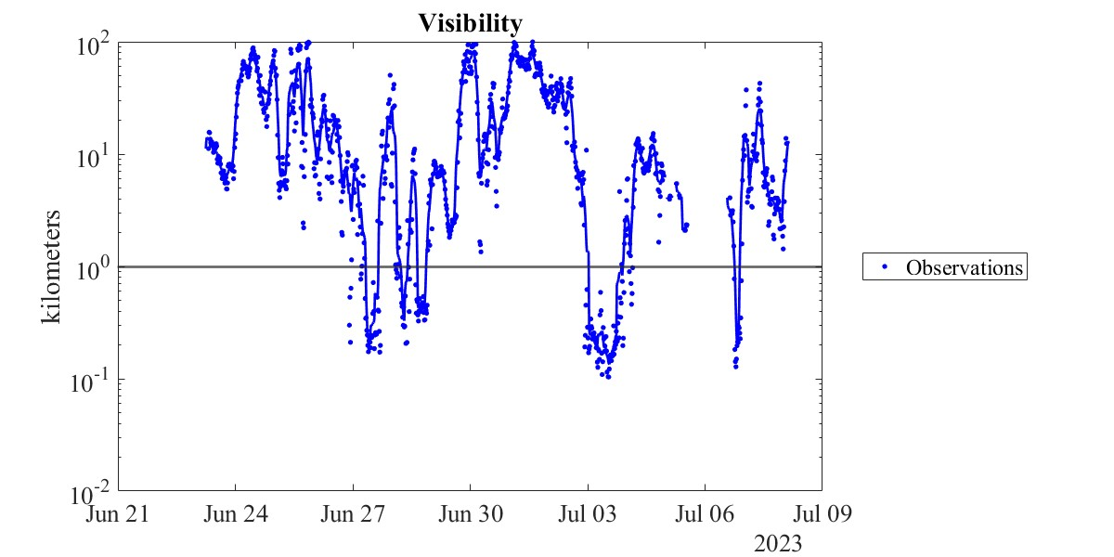
Comparisons - Visibility
Not fog
Fog

Slide 23
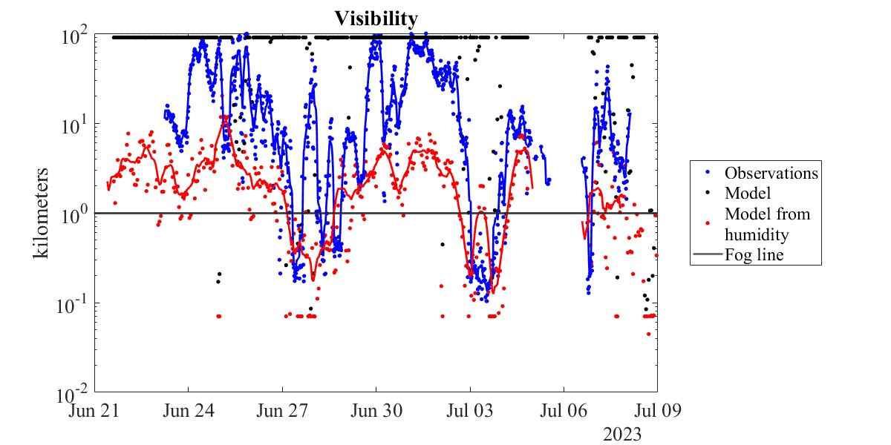
Comparisons - Visibility
Not fog
Fog

Slide 24
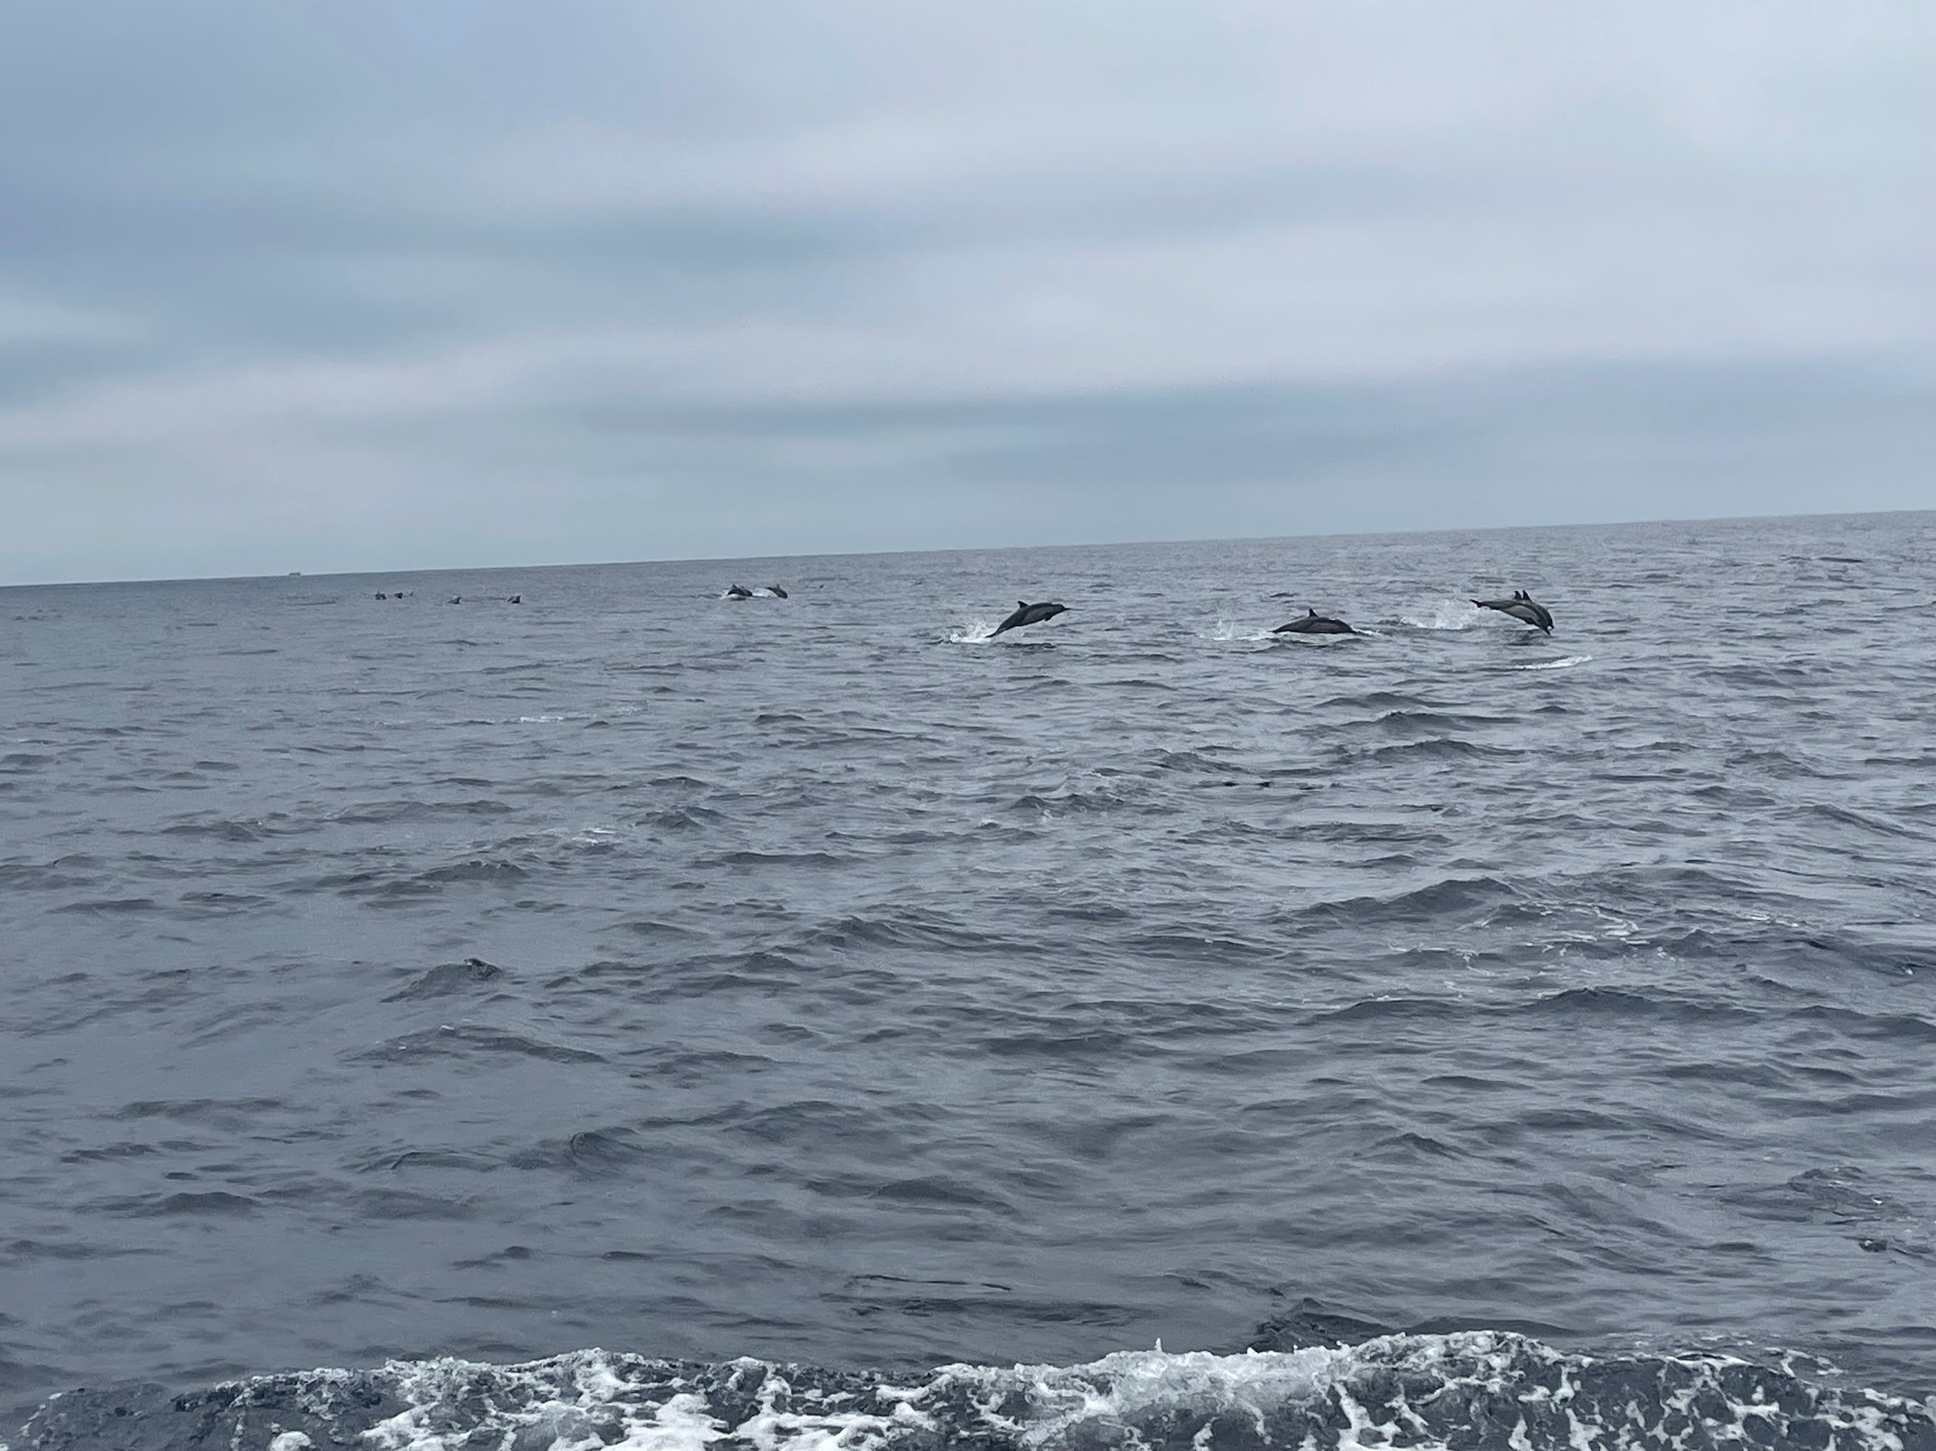
Conclusions and Future Work
Model shows good skill at predicting observed atmospheric conditions
It struggles with small-scale fluctuations that affect the system
Inability to deploy wave gliders and single-track of data make it difficult to draw as many conclusions as we would like
Future work
Do a 2-D interpolation
THANK YOU

Slide 25
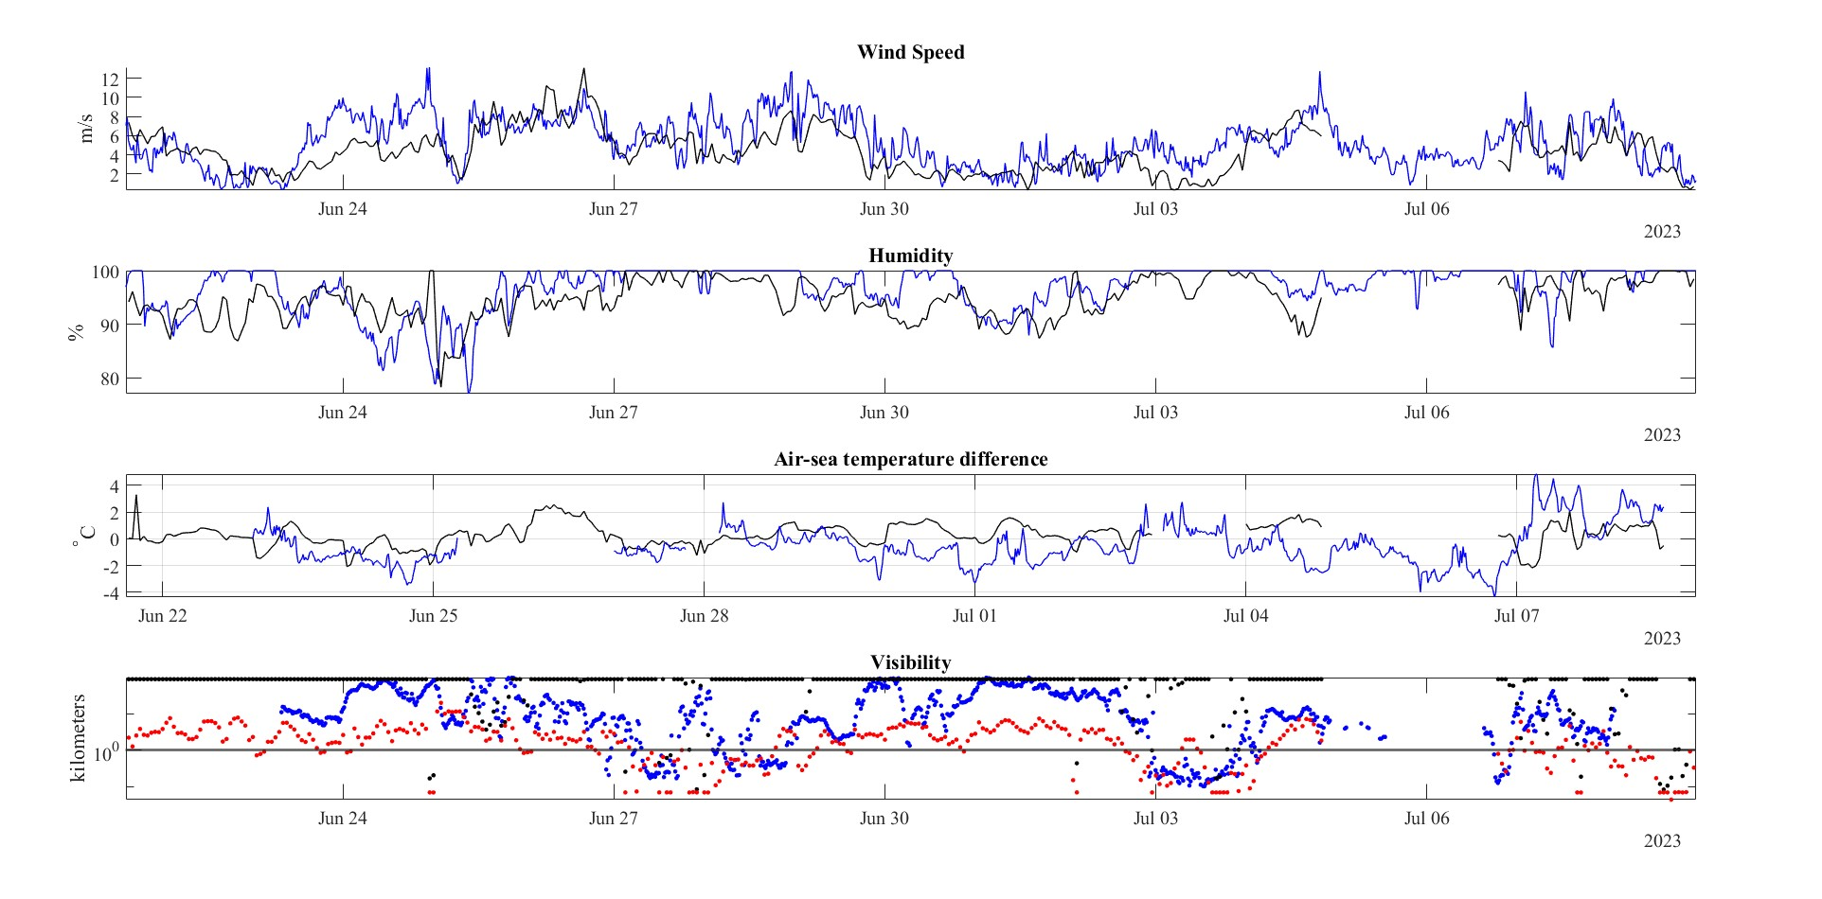
Fog Events
Wind?
Humidity is 100% during fog events
Air is warmer than ocean during fog

Slide 26
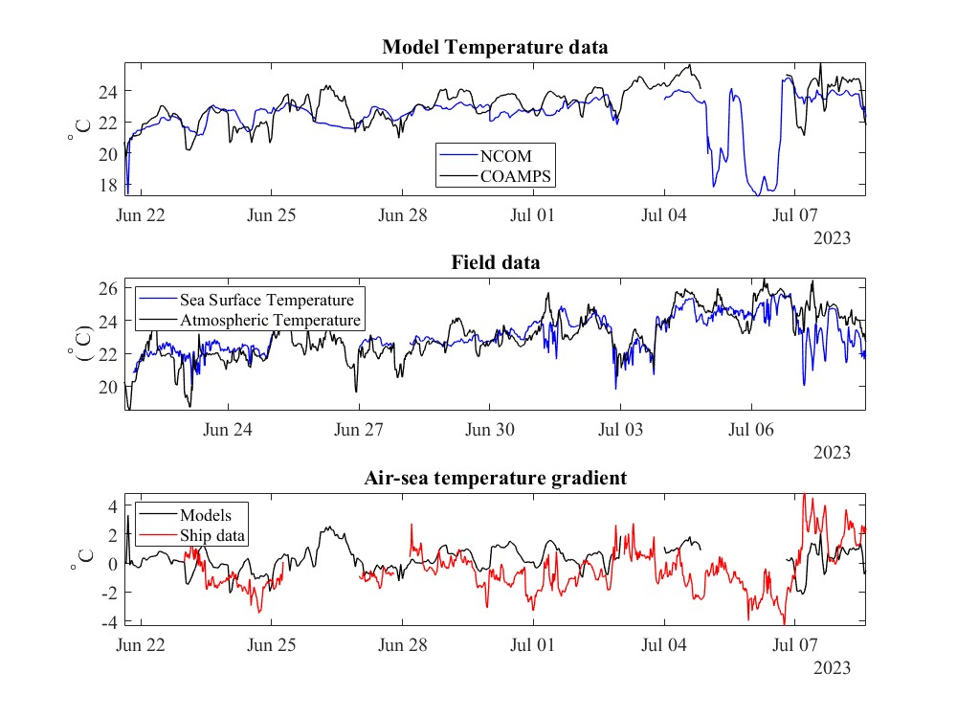
Comparisons - ΔT
Fog occurs when T_{air}>SST (see Formby-Fernandez et al)
Air-Sea Temperature Difference

Slide 27
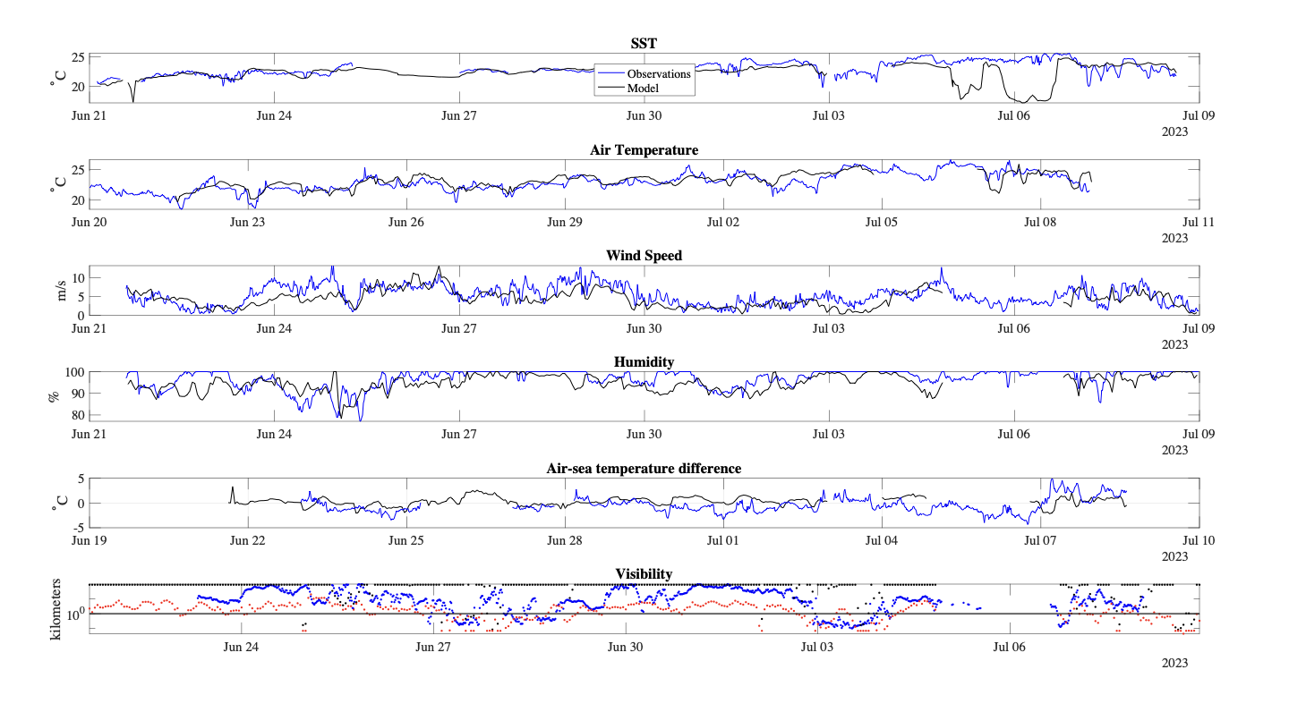
Fog Events
Wind?
Humidity is 100% during fog events
Air is warmer than ocean during fog

Slide 28
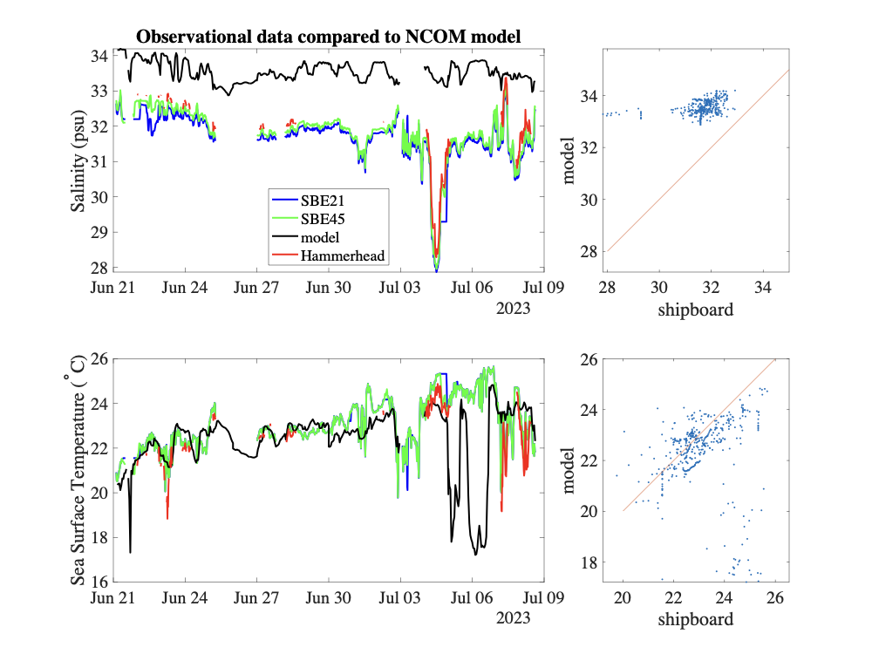
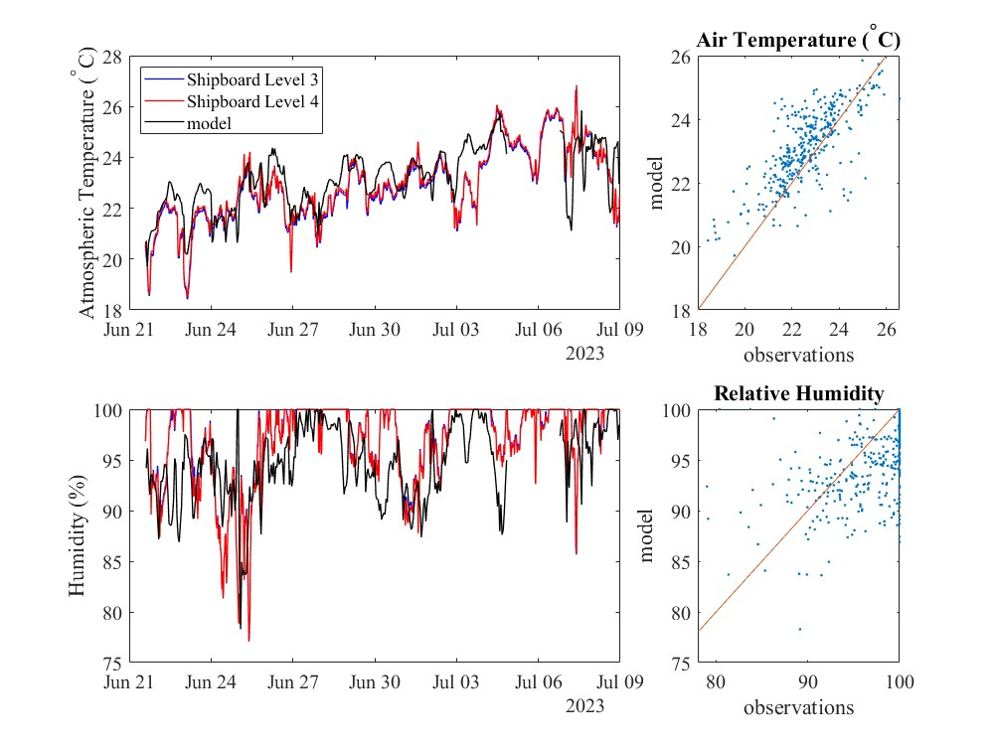
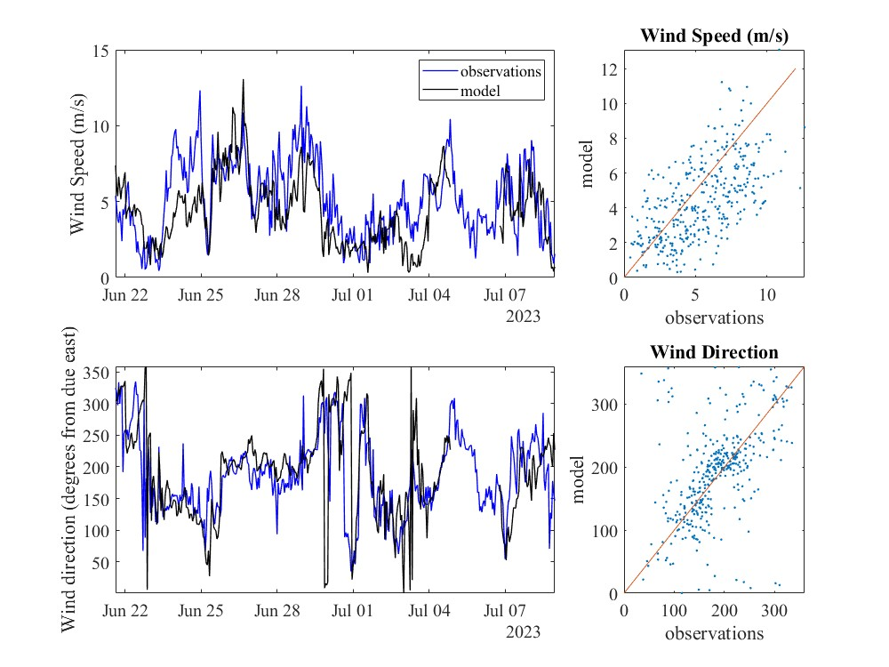
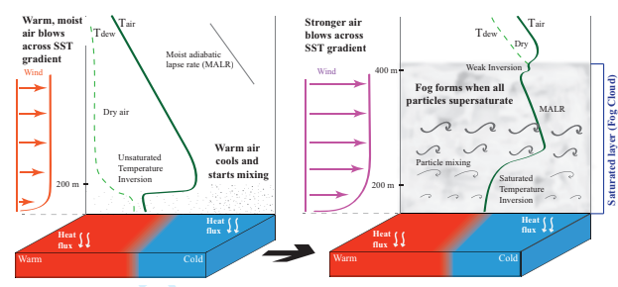
extra
Fog and Turbulence Interactions in the Marine Atmosphere (FATIMA) is a multi-university project aimed at improving knowledge and prediction capabilities of marine fog.
The Air-Sea Interaction Laboratory participated in two research campaigns
Summer 2022 at Sable Island in Canada
Summer 2023 in the Yellow Sea
Goals of this summer project:
Assess model performance relative to observations
Examine physical processes relevant to fog
Formby-Fernandez et al, Spatial and temporal structure of the fog life cycle over Atlantic Canada and the Grand Banks

